Slide 1
Development of AI-enabled Voice-based Digital Payment Application in Indian Regional Languages
International Institute of Information Technology, Naya Raipur

Slide 2
Problem Statement
To develop an AI-enabled voice based mobile application for digital transactions with regional language support for illiterate, rural people and people with disabilities.

Slide 3
Objectives
To develop an end to end voice-based mobile application for day to day digital transactions.
To provide regional language support for the native people
To collect huge volumes of voice data from various regions of people for better model development.
To provide user-friendly UI and voice assistant to guide illiterate and physically impaired users in making digital transactions.

Slide 4
Literature Review
Paper Title | Methods used | Limitations
Voice Based Form Filling System For Visually Challenged People | Google voice recognition, Text to Speech, Speech to Text, Voice access, Button mapping technology, OTG adaptor, printer, and Android studio application system | This system is not accessible to all particularly those with speech impairments or hearing impairments.
Development of a Voice Chatbot for Payment Using Amazon Lex Service with ‘Eyowo’ as Payment Platform | ASR,NLU,Speech Synthesis,Payment Platform(i.e Eyowo) | Amazon Lex is not multilingual and also integration of chatbot with Eyowo is quite complex.
Notes:
Changes to be done

Slide 5
Literature Review
Paper Title | Methods used | Limitations
Voice Based Security System using CNN | Speech recognition,NLU,Dialog management,ML,Sentiment analysis | This system has limited vocabulary,susceptibility to environmental noise,limited user identification and accuracy issues.
Voice Based Mail System for Visually Impaired | Google Text to Speech, Text to Speech, Speech to Text, Simple Mail Transfer Protocol | Inability to read attachments,Limited control over formatting
Notes:
Changes to be done

Slide 6
Proposed Solution
The proposed solution will be using AI (Artificial Intelligence) and NLP (National Language Processing).The suggested solution will have the following features -
Two-factor authentication (voice and fingerprint biometrics)
Automatic Speech Recognition and speech synthesis
Functions like making payments, checking bank balance, transaction history etc in their respective local language.

Slide 7
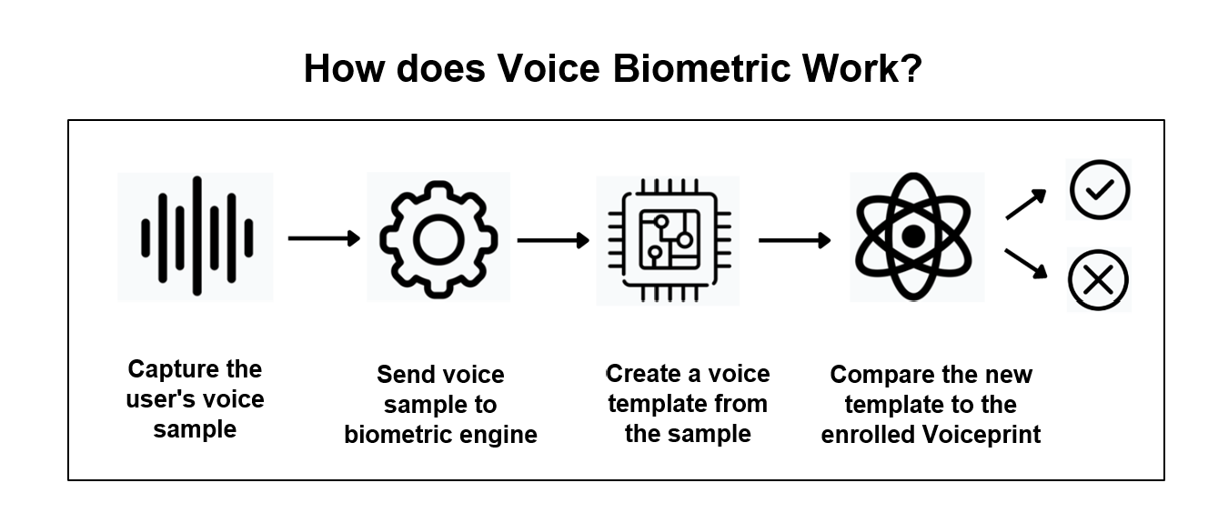
Methodology (Two-factor authentication)
Authentication of real-time biometric voice
Notes:
Authentication of real-time biometric voice
If it is a new user, a one-time enrolment can generate a unique voice ID.
The uniquely generated voice ID will be linked with the account.
Every speech includes speaker identification(compare a voice sample from an unknown identity against multiple enrollment templates), which confirms every request because no two people can have the same trait.

Slide 8
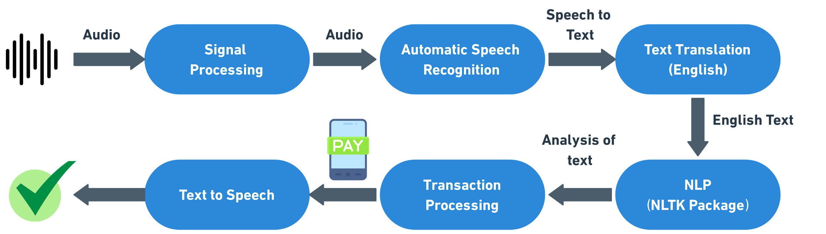
Methodology
The proposed solution consists of following steps-

Slide 9
Methodology
Major steps in processing are-
1.Speech to text
2.Text Translation to English Language
3.Analysis of text with Python NLTK Package
Notes:
To make a voice-based payment application in localized languages, the most critical task is to create a virtual voice assistant.
We will collect the data of India's voices in a local language and train the model to make a voice assistant.
Recent techniques, which we will employ in this project to create an effective voice assistant, makes use of the voice assistant feature and employs ASR (Automatic Speech Recognition) technology.

Slide 10
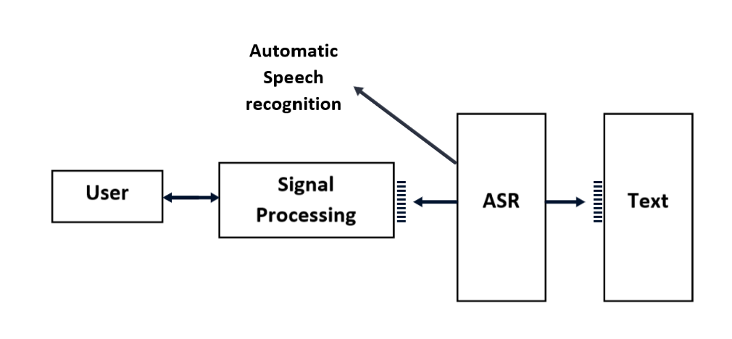
Methodology(Speech to Text)
Step 1:Automatic Speech Recognition
Notes:
Here, in the first step, the speech is recorded and the wav file is created.
Then, the wave file will be cleaned so that the background noise would get deleted. The volume will be normalized, then it will break down into elements, and it will be analyzed in sequences.
The ASR software examines these sequences it implements statistical probability to find out the entire words and then get processed into text content.

Slide 11
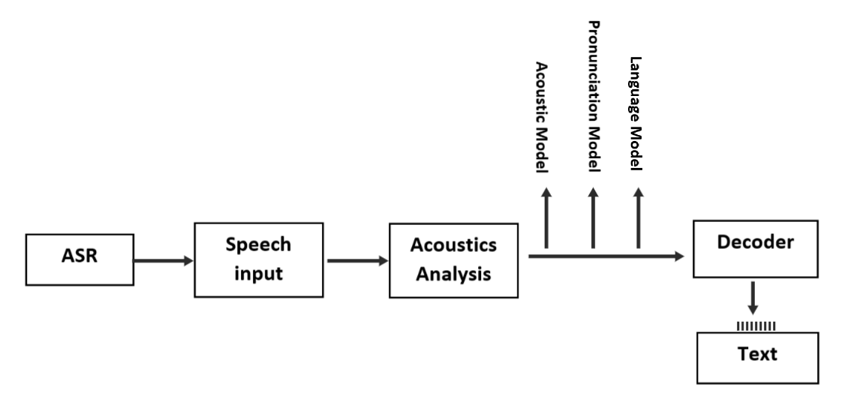
Methodology(ASR Workflow)
Step 1:Automatic Speech Recognition
Notes:
The system begins with the device gathering audio with the source, where the source is a microphone.
Recorded speech waveforms will be sent to acoustic analysis, performed on three levels.
The three modeling are as follows:
Acoustic Modeling: represents whether the elements were pronounced or not
Pronunciation Modeling: analyses of how these elements are pronounced will be checked
Language Modeling: usually trained toward finding contextual probabilities counting on what elements were gained
How Does Automatic Speech Recognition Work?
There are two parts to automatic speech recognition:
Recognizing phonemes and words
Responding appropriately
The first step involves the computer identifying phonemes. These are the slightest sounds humans can make with their voices. The machine runs your voice through a stenograph as you speak into a microphone. This tool recognizes the phonemes in your voice.
It then uses Natual Language Processing (NLP) to translate phonemes into readable text. It does that by comparing those recordings against databases of stored transcriptions.
Sometimes these are generated by actual humans. Sometimes they are compared against a neural network or deep learning algorithm.
The system will then make corrections as needed.
Components of an ASR System
There are four main components of an automatic speech recognition system. These include:
Feature Extraction
Acoustic Modeling
Language Model
Classification/Scoring
Each plays an essential role in helping computers understand our words and actions.
Feature Extraction
Feature extraction extracts features from audio recordings. Think of features as word fingerprints that help identify spoken words. They identify specific characteristics such as pitch, volume, and accent.
Acoustic Modeling
This model turns extracted features into a statistical parametric speech model. It will then compare against other models based on likelihood ratios.
Language Model
A language model helps the machine determine which word sequences are possible. It uses grammar rules and probabilities for certain sounds occurring together within sentences.
Classification and Scoring
A fancy term that means we've taken everything above and determined whether or not it was correct.
If not, try again until you get it right. Once a system has gotten to that point, it will read through your data. It will extract features and make comparisons between models. Then it will decide on a final result.
This process will repeat many times per second. Once it's reached an acceptable level of accuracy, it will move on.

Slide 12
Methodology(Text Translation)
Step 2: Text Translation using Deep Learning.
Pre-Processing the Text Data
Clean Text
Split Text
Train the Language Translation Model(used encoder-decoder LSTM model)
Notes:
https://www.fireblazeaischool.in/blogs/language-translation-using-deep-learning/

Slide 13
Methodology(Analysis of Text)
Step 3: Analysis of text with Python NLTK Package
Tokenization — convert sentences to words
Removing unnecessary punctuation, tags
Removing stop words — frequent words such as ”the”, ”is”, etc. that do not have specific semantic
Stemming — words are reduced to a root by removing inflection through dropping unnecessary characters, usually a suffix.
POS tagging — is the task of labeling the words in text according to their part of speech.
Lemmatization — reduces words to their core meaning
Chunking — allows to identify phrases.
Named Entity Recognition — finds the named entities in texts
Notes:
https://www.fireblazeaischool.in/blogs/language-translation-using-deep-learning/

Slide 14
Methodology(Analysis of Text)
Step 3: Analysis of text with Python NLTK Package
Analysis consists of following steps-
Extraction of name of the person using Transliteration.
Identifying tokens that represent numbers.
Matching the function word (pay,check balance, and transaction history) with the dictionary made by us ﻿
Based on the function word, it was determined which service to perform.
Notes:
Transliteration is the process of transferring a word from the alphabet of one language to another.

Slide 15
Tools and Technologies
Tech Stack and Software requirement
Frontend: React Native for both iOS and Android
Backend: Python Flask framework
Database: MongoDb
IDE: Visual Studio Code
Version Control: Git
Deployment: App store (for iOS) and play store (for Android)

Slide 16
Tools and Technologies
Third-Party Integration Requirements
Google Translate
Google Authentication

Slide 17
Implementation
Prototype and Python Code
Functional Flow
Online Payment Flow

Slide 18
Functional Flow
Functional flow involves the following steps:
User registration and sign in process
Voice payment flow
Payment transaction process

Slide 19
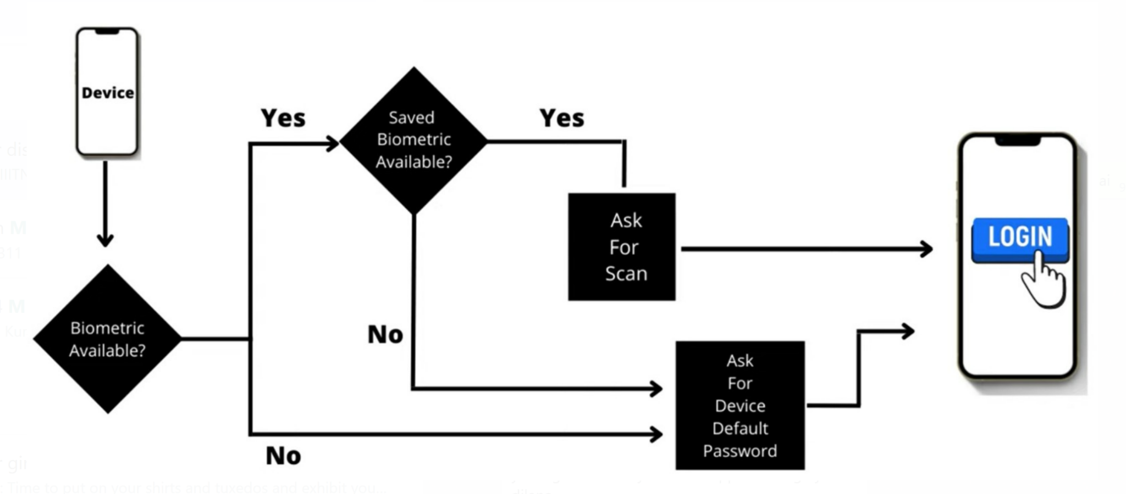
Functional Flow (User Registration Process)
Notes:
First the new user will register his voice.
A unique voice id will be generated for each user
Then the user will select his/her bank, enter his mobile number and OTP will be generated and send to user for verification
Then ones the user is verified, the registration will be successful

Slide 20
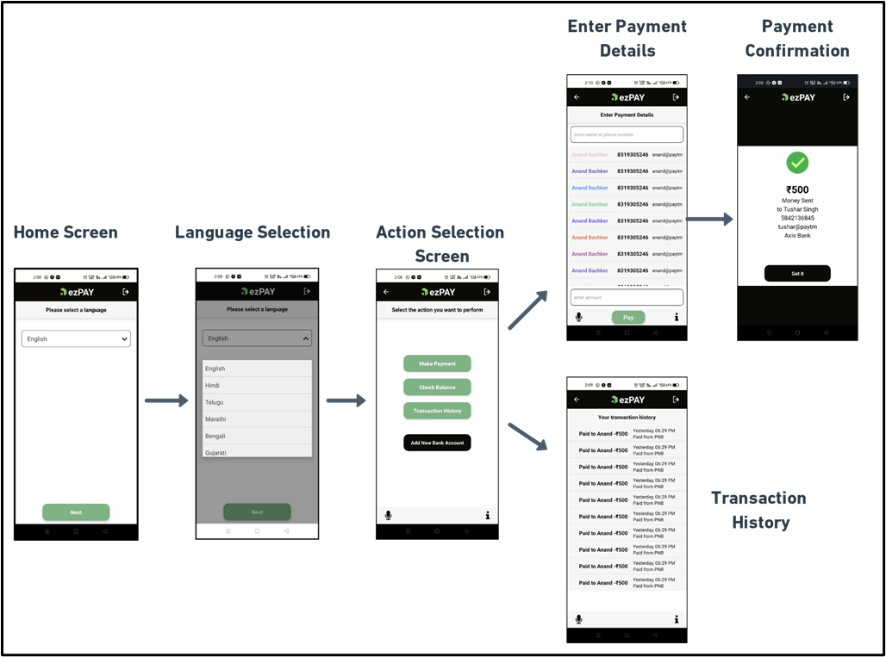
Functional Flow (Payment Transaction Process)
Notes:
1. The user registers and chooses their preferred language for the app's operation. Blind persons can also select the option to always receive audio instructions while using the app.
2. The microphone or volume button (for blind) can be used by the user to activate the microphone for giving voice commands.
3. The info button or automatic (for blind) can be used for giving voice instructions from the app.
4. After selecting the language, the app functions in that language only.
5. The user has the choice of selecting an action or providing vocal instructions.
6. Based on the selected action app performs the following tasks as shown in Fig 4.
7. The payment success message is delivered to a user.

Slide 21
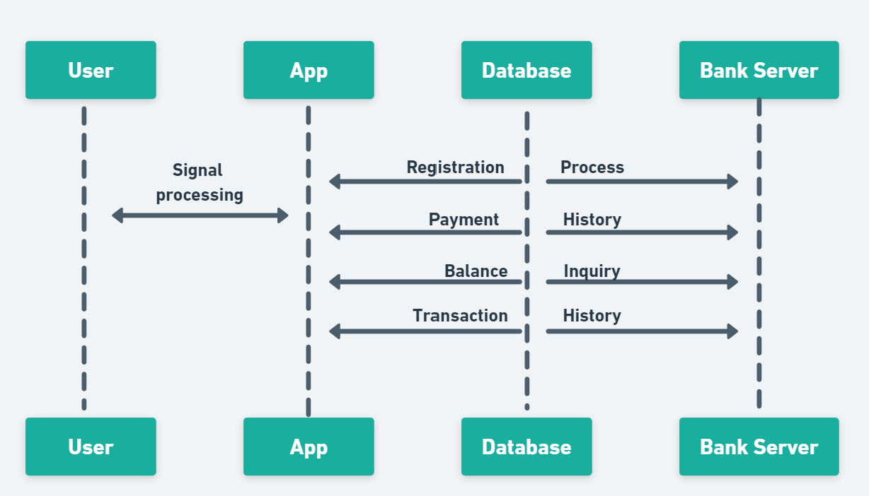
Functional Flow (Transaction process)
Notes:
This includes connecting the app with the payment gateway and performing different functionalities like payments, checking balance and checking transaction history. Now let us come to how the communication between us and the bank server will happen

Slide 22
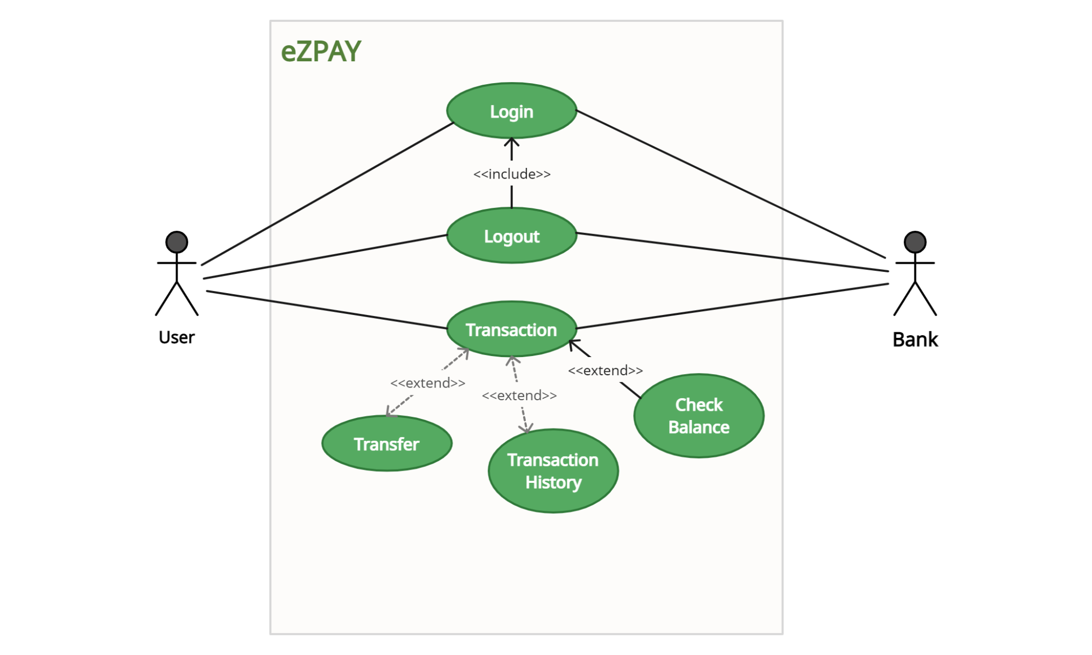
Use Case Diagram

Slide 23
Results and Testing
No.of languages supported: 19
No.of languages tested: 5

Slide 24
Deliverables
Mobile application for illiterate people, regional language speakers and blind or visually impaired person to make payments in their respective local language, know their bank balance and transaction history and make transactions by speaking (voice input).

Slide 25
Novelty of the project
None of the existing payment methods has multilingual support for different regions of India
User friendly UI with voice assistant for physically impaired, illiterate and rural people.
Two factor authentication (using voice recognition and biometrics)

Slide 26
Conclusion
The AI based developed application will solve the problem of illiterate people, regional language speakers and blind or visually impaired person of going through process of filling up the details manually for performing a digital transaction by providing easy to use voice-based interface.

Slide 27
References
1. D. B. Fry, “Theoretical aspects of the mechanical speech recognition,” J. Br. Inst. Radio Eng., Vol. 19, no. 4, pp. 211-218, 1959.
2. T. K. Vintsyuk, “Speech discrimination by dynamic programming,” Kibernetika, Vol. 4, pp. 52-57, 1968.
3. L. R. Rabiner, S. E. Levinson, A. E. Rosenberg, and J. G. Wilpon, “Speaker independent recognition of isolated words using clustering techniques,” IEEE Trans. Acoustic. Speech Signal Process, Vol. 27, pp. 336-349, 1979.
4. J. G. Wilpon, L. R. Rabiner, C. H. Lee, and E. Goldman, “Automatic recognition of keywords in unconstrained speech using hidden Markov models,” IEEE Trans. Acoustic. Speech Signal Process, Vol. 38, pp. 1870-1878, 1990.
5. S. K. Sahoo, T. Choubisa, and S. R. M. Prasanna, “Multimodal biometric person authentication: a review,” IETE Tech. Rev., Vol. 29, no. 1, pp. 54-75, 2012

Slide 28

Thank You!
..
Dr. Shyama Prasad Mukherjee International Institute of Information Technology, Naya Raipur
International Institute of Information Technology, Naya Raipur

